Slide 1
DATA 400
Analyzing NYC Subway Delays: Economic Costs & Predictive Insights
By Hannie Pham
Spring 2025- Mini Project

Slide 2
Agenda
01.
02.
03.
04.
Project Introduction
Dataset & Methodologies
Data Analysis and Predictive Model
Implications for Stakeholders
05.
Ethical, Legal, Societal Implications

Slide 3
01.
Project Introduction

Slide 4
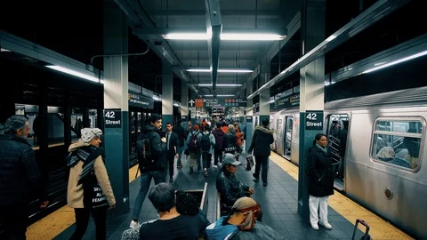
The Big Question❓
"Which NYC subway lines are most susceptible to delays, and how can this information be used to predict the economic cost of commuting inefficiencies?"

Slide 5
02.
Dataset & Methodologies

Slide 6
About DATASET
The dataset used in this study comes from Data.Gov website:
MTA Subway Customer Journey-Focused Metrics dataset.
It captures +2000 observations that track subway passenger delays, travel times, and customer journey performance across different lines and divisions.
Some key variables include:
+ Transit Metrics: Additional platform time, additional train time, total journey time.
+ Delay Indicators: Number of passengers experiencing delays over five minutes, delay percentages.
+ Subway Details: Subway division, line, and time period (peak vs. off-peak).

Slide 7
Methodologies
Data Collection & Preprocessing
Involved handling missing values, converting date formats, standardizing categorical variables, and removing outliers using the IQR method to ensure reliable insights
Exploratory Data Analysis (EDA) - Identifying delay patterns and trends over time.
Predictive Modeling - Random Forest Regressor
Economic Cost Estimation - Converting delay time into lost wages

Slide 8
02.
Exploratory Data Analysis (EDA)

Slide 9
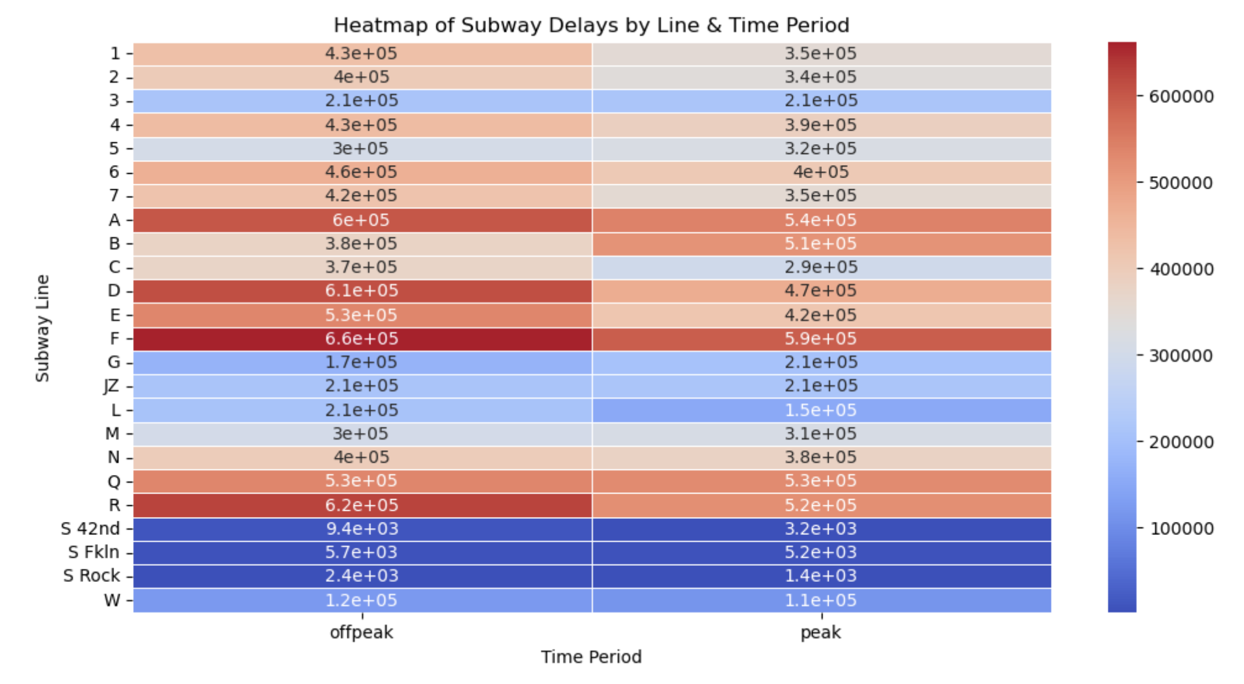
Identifying Delay Patterns
Notes:
The heatmap on the left shows the total delays by subway line during off-peak and peak hours. The redder the color, the greater the delay. The data clearly highlights that the F line experiences the highest number of delays, both during peak and off-peak hours. Similarly, lines like A, D, and R also experience significant congestion.

Slide 10
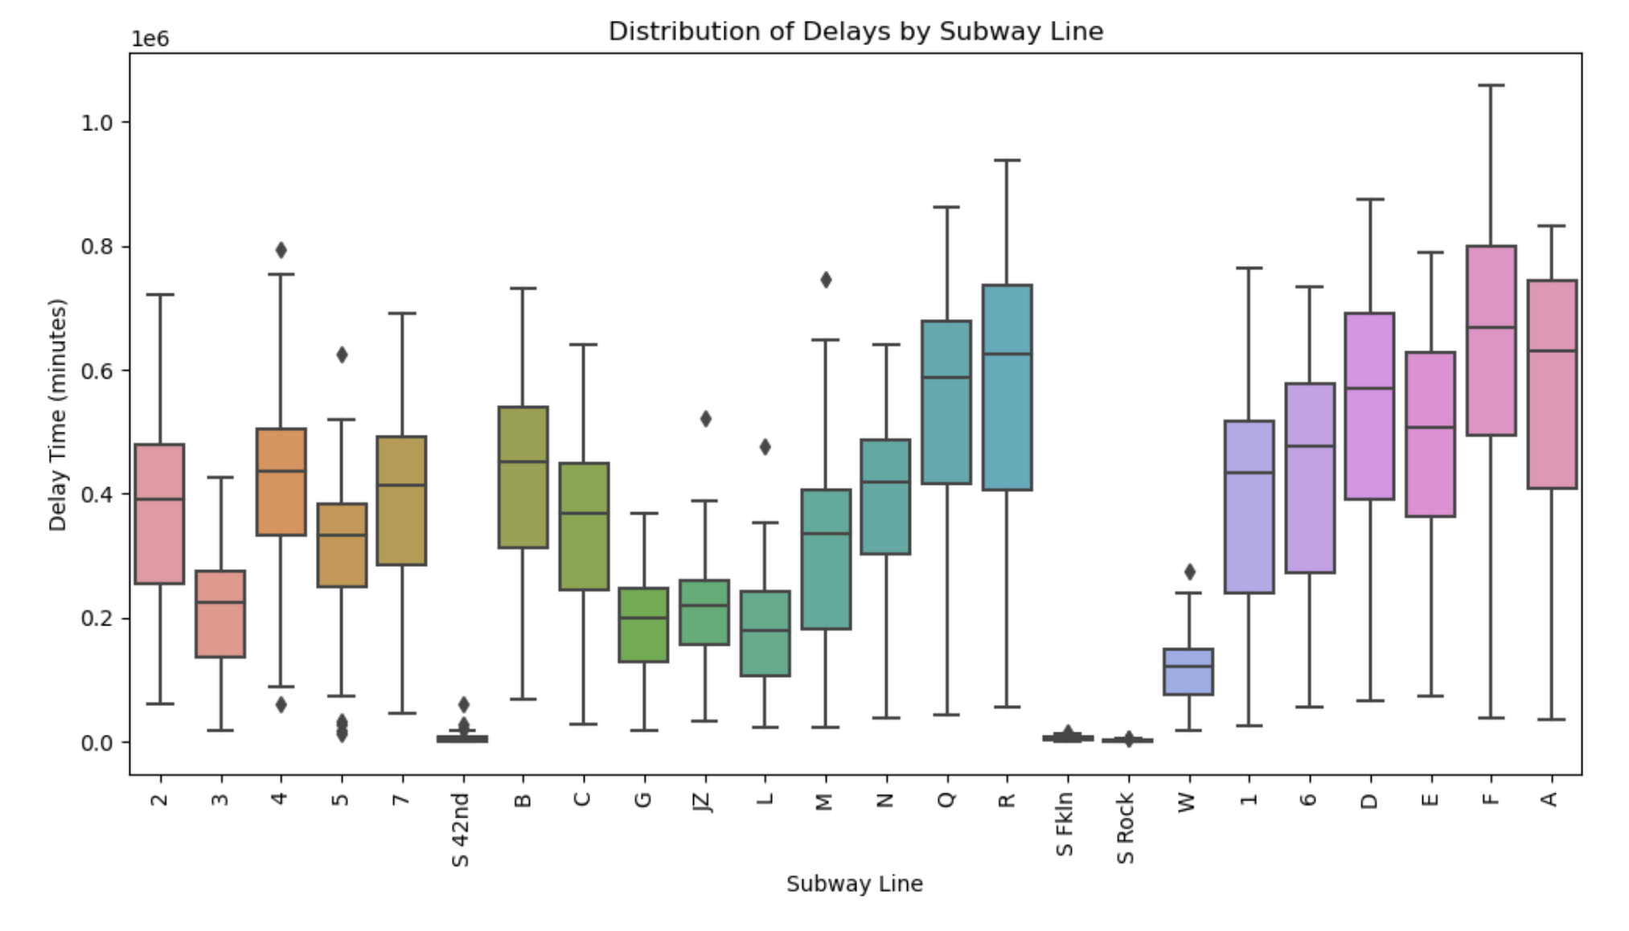
Identifying Delay Patterns
Notes:
We can see that some lines, like A, F, and R, have higher median delays and more extreme outliers, meaning that these lines consistently experience significant disruptions.
These findings confirm that *certain subway lines experience much higher delays than others, making them primary candidates for scheduling optimizations and infrastructure improvements.

Slide 11
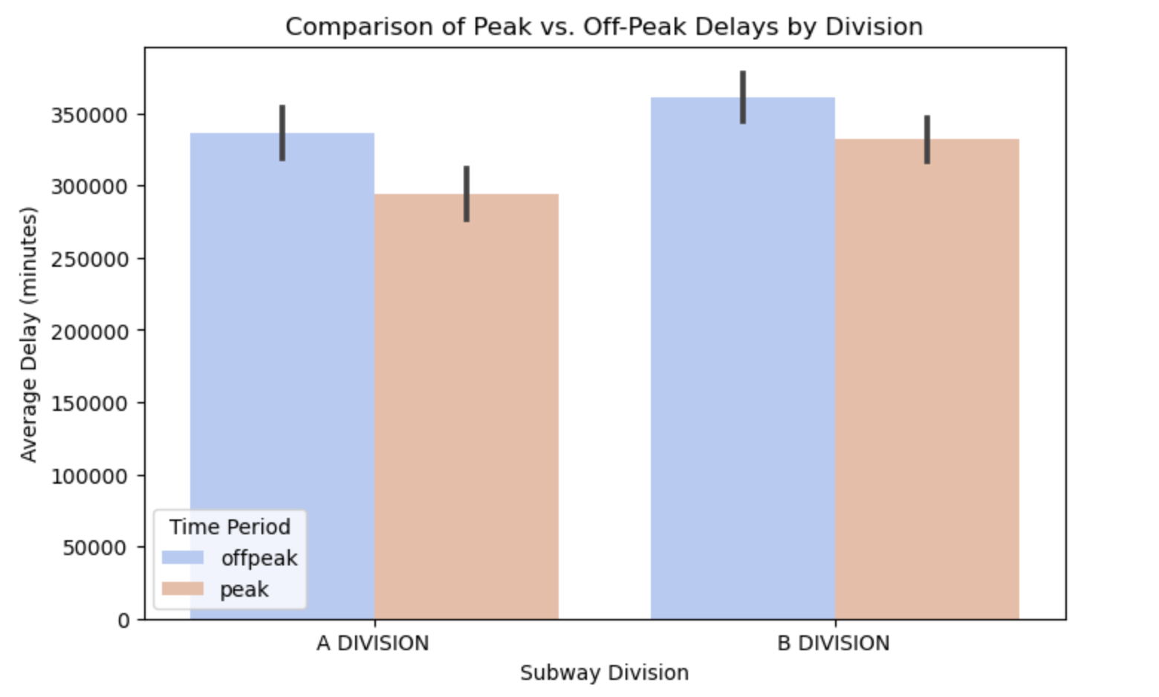
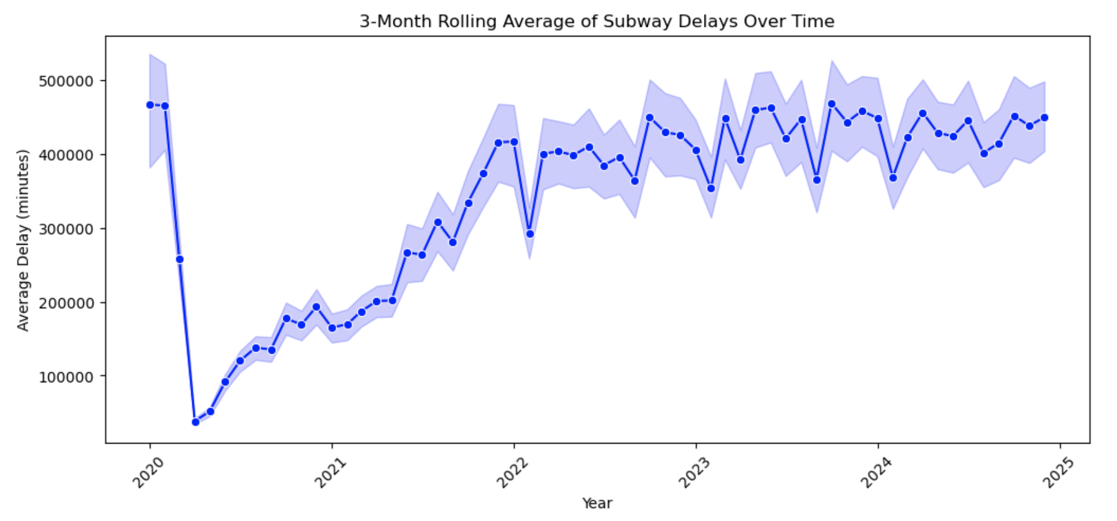
Trends Over Time
Notes:
We can see that delays increased significantly from 2020 to 2022, with fluctuations that could be attributed to factors like ridership recovery post-pandemic, track maintenance work, or policy changes. These long-term trends suggest that while delays are not static, they follow predictable seasonal and operational patterns.
On the right, I compared peak vs. off-peak delays by subway division. While I expected peak-hour delays to be much higher, the data shows that both A and B Divisions experience substantial delays even during off-peak hours, though peak delays are slightly worse. This suggests that factors like platform congestion and train frequency adjustments play a bigger role in delays than just rush hour demand.

Slide 12
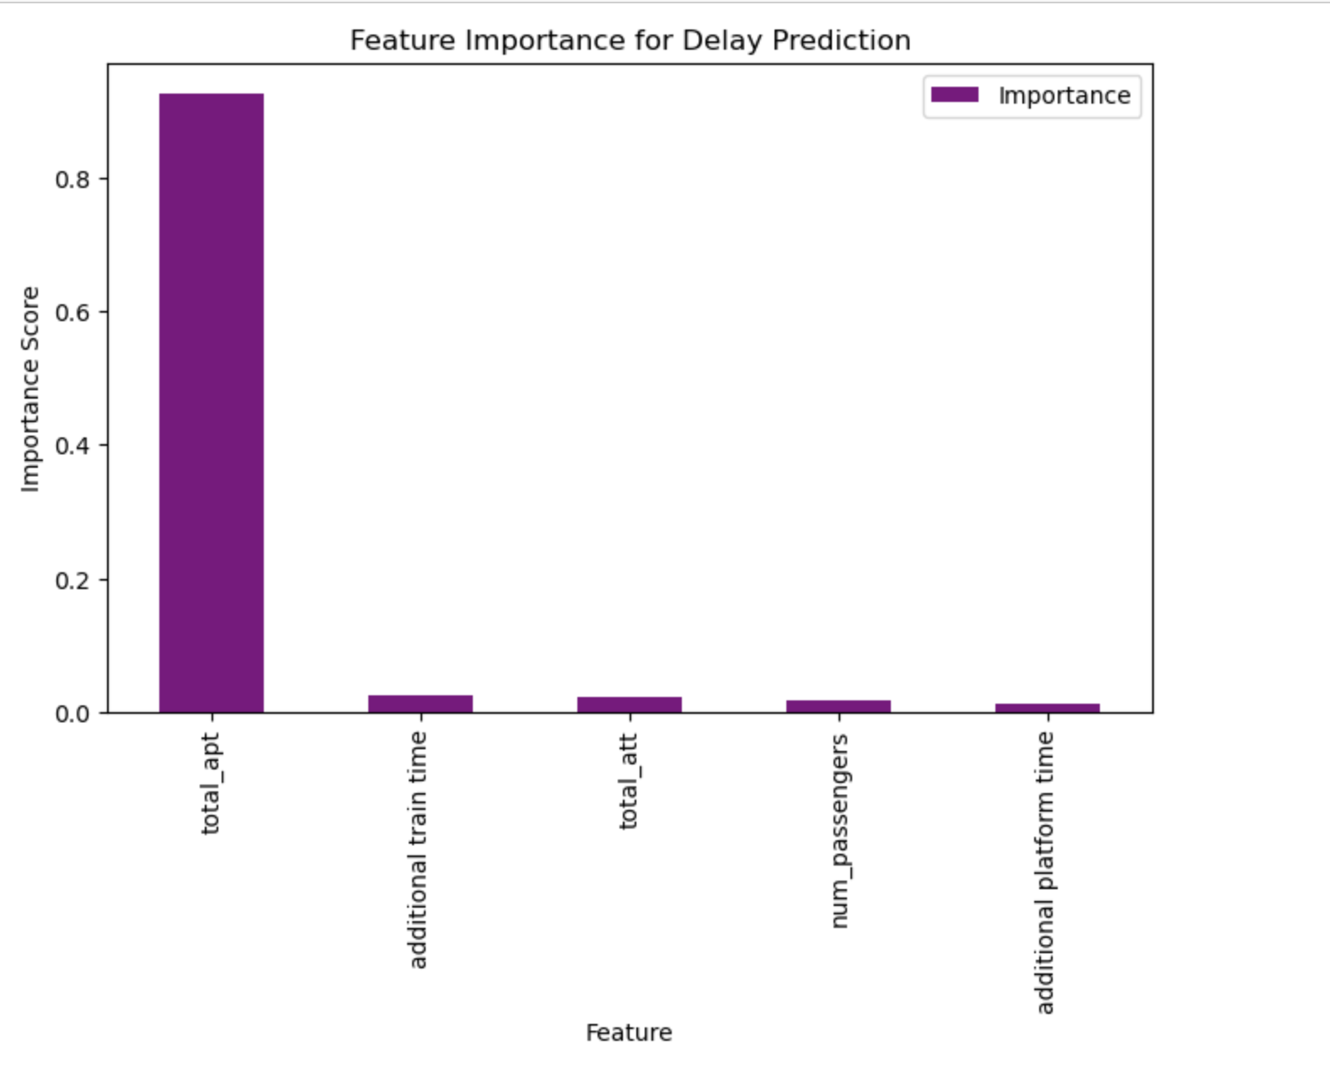
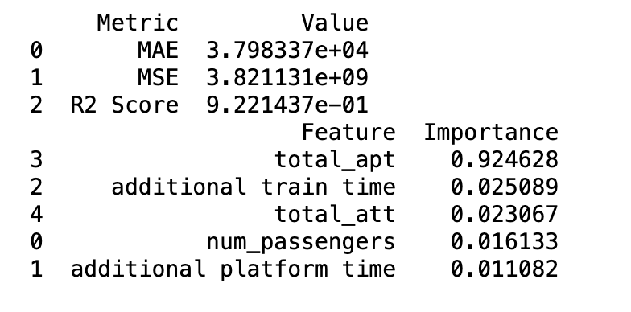
Predicting Future Delays
Notes:
I trained a Random Forest Regressor model to predict delays based on historical data. The table on the left shows the model’s performance metrics, with an R² score of 0.92, indicating high predictive accuracy.
The bar chart on the right shows the feature importance scores from our model. The most important factor influencing subway delays is Total Additional Platform Time. This means that the time passengers spend waiting on the platform—whether due to overcrowding, or slow boarding—is the strongest predictor of delays. Other factors like additional train time and total journey time had a much smaller impact.
This finding suggests that reducing platform congestion and improving boarding efficiency could significantly reduce subway delays.

Slide 13
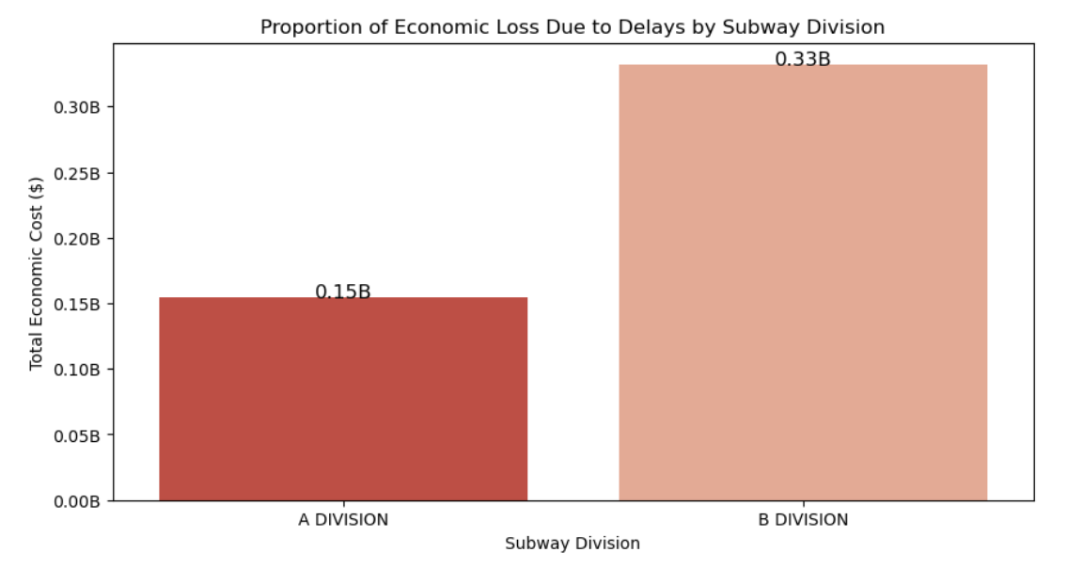
Economic Cost of Delays
Notes:
Now that we understand where and why delays happen, let’s look at their economic impact. This chart shows the total economic loss per subway division due to delays. I estimated this by converting lost time into lost wages, based on NYC’s average hourly wage of $30. (US Dept. of Labor).
My findings show that B Division accounts for the highest economic loss, estimated at $330 million per year, followed by A Division at $150 million. These numbers emphasize that subway delays are not just an inconvenience but a major economic burden for NYC commuters.
Reducing delays could result in significant financial savings for both individuals and businesses, reinforcing the need for smarter transit management.

Slide 14
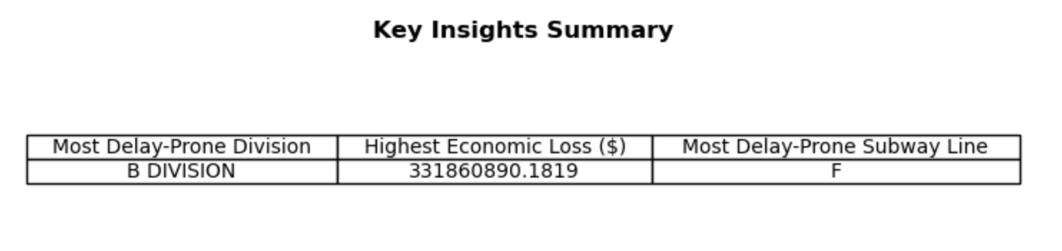
Summary
Notes about External Factors:
Weather & Seasonal Effects – Extreme weather (snow, rain, heat waves) can disrupt train schedules, and seasonal ridership shifts may require adaptive scheduling.
Passenger Behavior & Travel Patterns – Changes in commuter habits, remote work trends, and unexpected events (e.g., pandemics) can impact subway ridership and delay patterns.

Slide 15
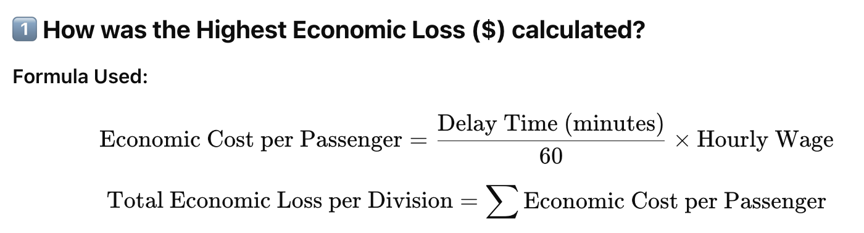
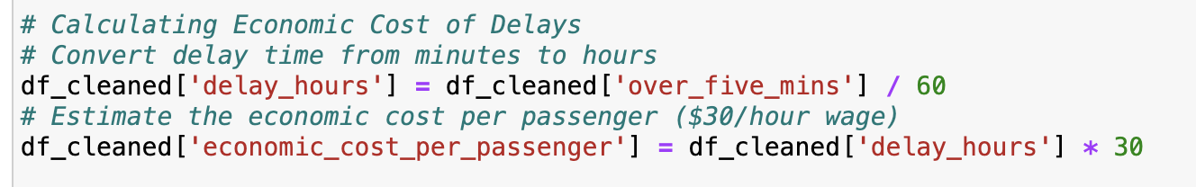
Formula and Code for Economic Loss

Slide 16
04.
Implications for Stakeholders

Slide 17
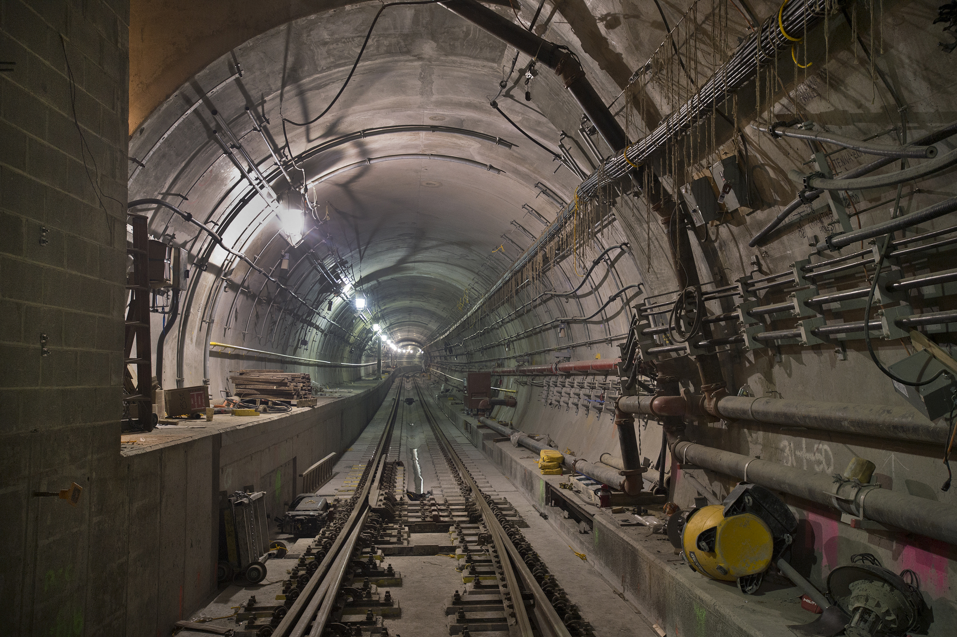
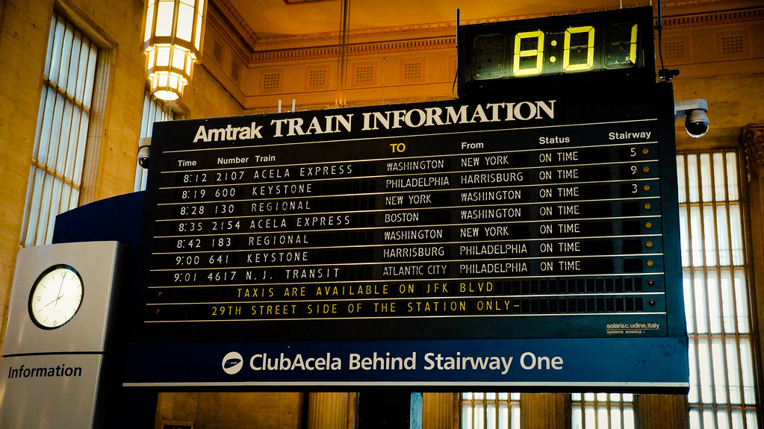
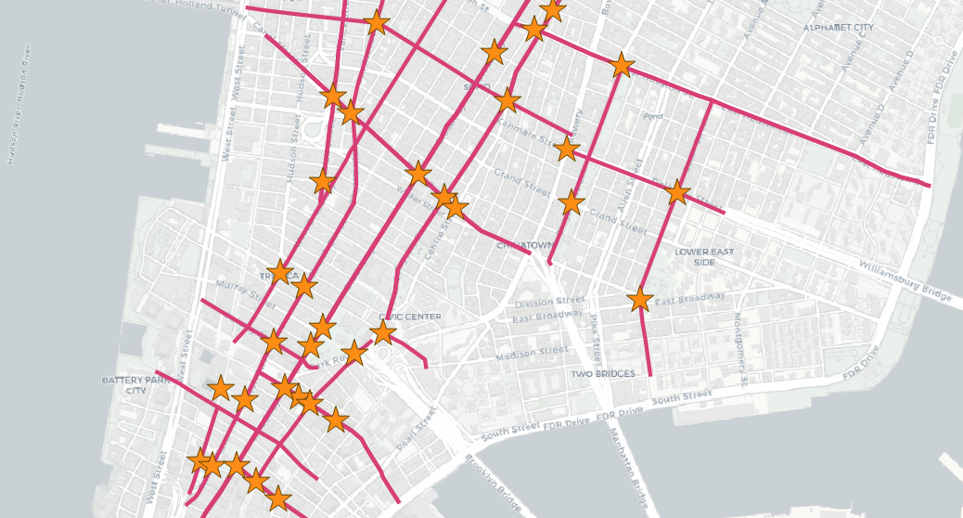
Conclusion & Recommendations
1️⃣
Improve infrastructure on delay-prone lines
2️⃣
Optimize train schedules to reduce platform congestion
3️⃣
Invest in data-driven subway management

Slide 18
05.
Ethical, Legal, Societal Implications

Slide 19
What have we learned?
1️⃣ Any infrastructure improvements or scheduling changes should not disproportionately disadvantage lower-income riders or underserved communities.
2️⃣ If real-time passenger tracking or AI-based scheduling is implemented, privacy concerns must be addressed to ensure ethical data collection and protection.
3️⃣ Infrastructure investments should align with eco-friendly urban planning rather than just economic cost-saving.

Slide 20

THANK YOU!

